Slide 1
“The Shoe”
Bar and Community
Space
Meeting on October 25th
5pm
at 908 North Broadway Ave
Rochester, MN 55906

Slide 2
Overview
Introductions
About our Project
The Application Process
Exhibits:
  Site Plan
  Building Elevation
  Floor plan
Q&A

Slide 3
Introductions
Matthew Jewison
  Co-Owner
Jack Lester
  Co-Owner
Eric Kramlinger
  Co-Owner
Paul Armon, AIA
  Architect at Armon Architecture, Inc.

Slide 4
About the Project
Proposed Change of use from Service to Bar or Tavern
The existing building would be retrofit to allow a 650sf bar.
Adding an ADA compliant restroom and Ramp.
Cleaning up the exterior with paint and new windows.
Adding a bar with community focus and non-alcoholic options.

Slide 5
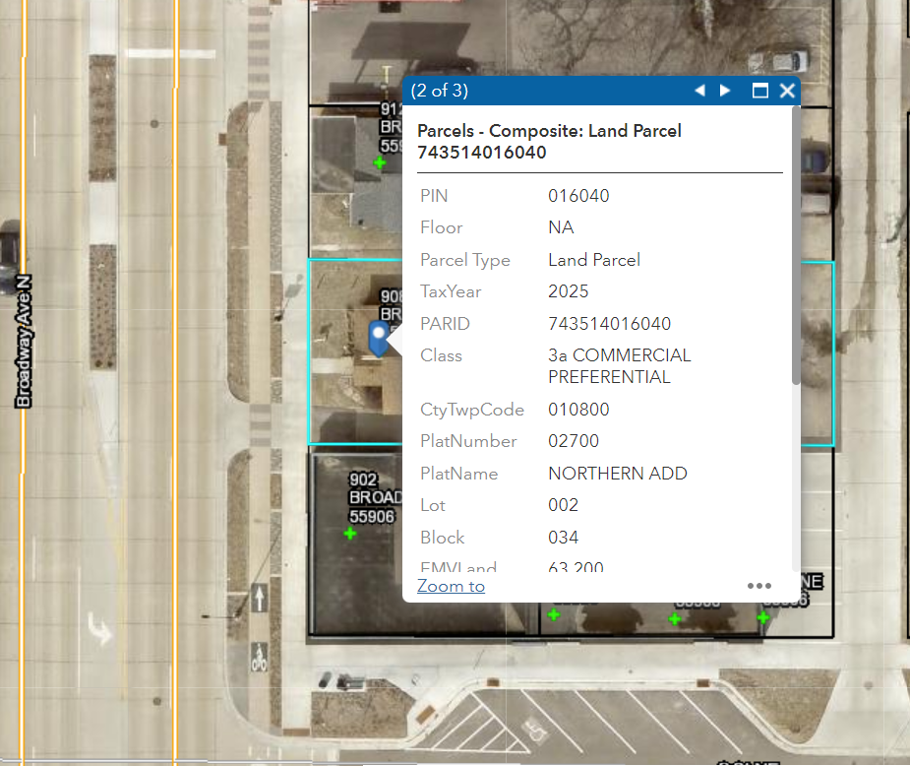
Application Process
Site Plan
  Parcil ID
    743514016040
  Zoning District:
    MXT-COR Transit-Oriented Development Corridor
  Existing
    1300sf 2 story building
    Setbacks
      Front (West): 0’
      Interior Side (North): 5’
      Street Side (South): 2’
      Rear (East): 5’
  Proposed
    650sf 1 story building
      Second floor would be deemed dead space
    Setbacks
      Front (West): 0’
      Interior Side (North): 5’
      Street Side (South): 2’
      Rear (East): 5’

Slide 6
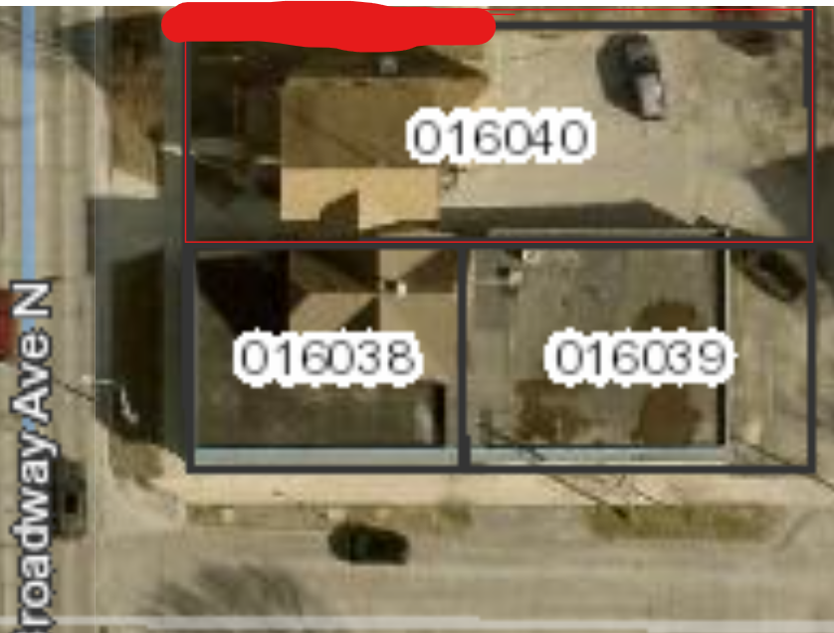
Landscaping
There is existing landscaping in front of the building from the Broadway project
We would be adding bushes and shrubs on the north side between our building and the residential structure shown in the photo by the red line.

Slide 7
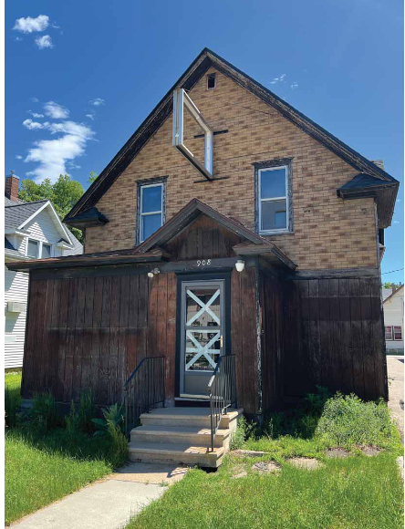
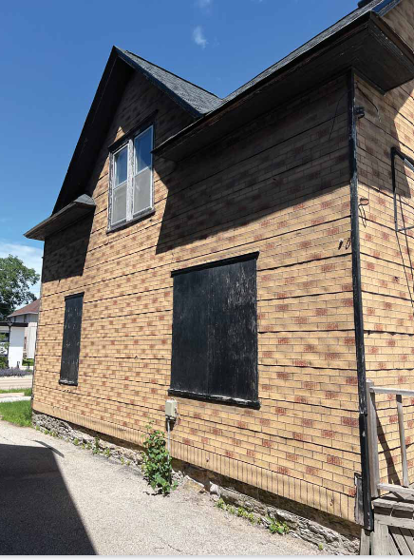
Building Elevations (not to be changed)
East (facing Broadway)
South (facing 9th street)

Slide 8
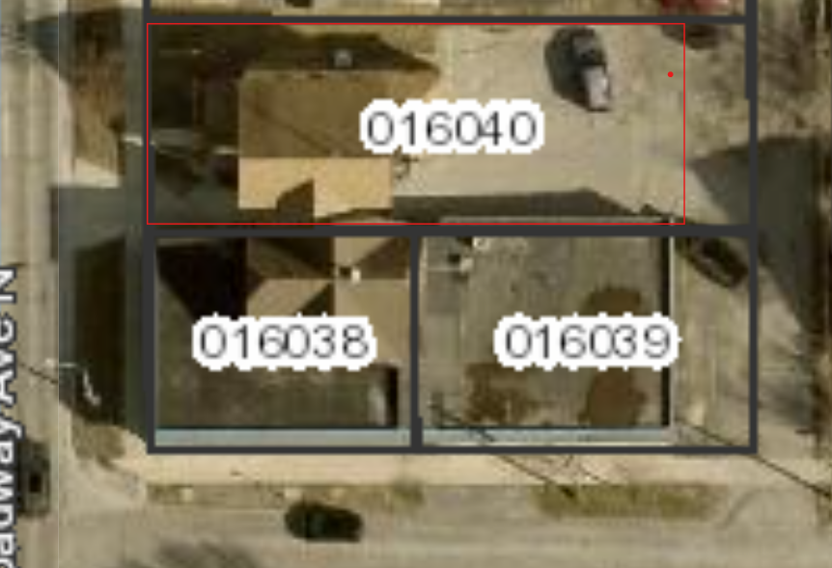
Photometric plan
There is no proposed change to the existing lighting

Slide 9
Questions and Answers
Still have Questions?
Contact the City of Rochester’s Community Development Department
with any questions about this application type via email
communitydevelopment@rochestermn.gov or phone (507-328-2600).

