Slide 1
Scenic Oaks West/Lakeview General Development Plan
Mark Hanson Development
NIM Meeting date: February 6th – 6:00PM
Location: 2704 Bentley Drive SW, Rochester, MN 55902
(Developers Spec Home)

Slide 2
Overview
Introductions
About our Project
The Application Process – General Development Plan which will be followed by Major Land Subdivision Permit for Scenic Oaks West Third and future phases of development
Exhibits:
General Development Plan Exhibits
Sanitary Sewer - Gravity versus Lift Station
Traffic Impacts
Q&A

Slide 3
Introduction
Mark Welch – P.E., G-Cubed Engineering
Senior Vice President – Civil Division Chief
Mark Hanson – Mark Hanson Development
Owner/Developer/Builder

Slide 4
About our Project
Location: property is south of Scenic Oaks West Second and south and west of Scenic Oaks Sixth Addition.
Proposal: Update the prior General Development Plans for Scenic Oaks West and Scenic Oaks Lakeview into one GDP with updates in line with the Unified Development Code and the Rochester Comprehensive Plan 2040. 171 lots are depicted with future public street connections to 60th Ave SW and two street stubs to undeveloped properties to the west.
Development Phasing – Scenic Oaks West Third timeline, utilities, future phases
Lot Mix – creation of pockets of HOA administered Villa projects along with single family. Following the success of mixing Villas projects into the later phases of the Scenic Oaks development and both platted phases of Scenic Oaks West.
Impacts on neighbors – Connections to street network, utilities
Environmental – Avoidance of delineated wetlands, work near Shoreland and Floodplain of Willow Creek Reservoir
Airport Zoning – requirement for 1+ acre lots

Slide 5
The Application Process
Applicant meets with City Teammates to review application requirements
GET INVOLVED:
Attend Applicant-hosted Neighborhood Information Meeting
Applicant submits Development Application within 30 days of Neighborhood Information Meeting
Full Application Review by City, County, & State departments within 14 days of receiving application
If application meets all requirements, application is approved
Applicant completes other required applications & sign-offs (i.e. building permit, grading permit, etc.)
Applicant proceeds with Project

Slide 6
Zoning
Permitted Uses
R-1 and R-2 – All lots proposed follow the R-1 zoning. Only a portion of what will be platted as Scenic Oaks West Third is zoned R-2. R-2 zoning does allow for duplex, triplex and quadplex units. The developer maintains architectural review and approval of all buildings and will not allow for any structure other than single family detached within the development.
Permitted use – Mixed Single-Family
Minimum allowed lot dimensions: 5000 sq ft and 60 foot width – most lots are between 80 and 100 feet in width.
Building Setbacks
15’ Front – developer will continue the maintaining a minimum of 20 feet to the garage
5’ Interior Side
12’ Street Side
12’ Minimum Sum of Interior Side Yards
20’ rear
Building height Max – 35 feet

Slide 7
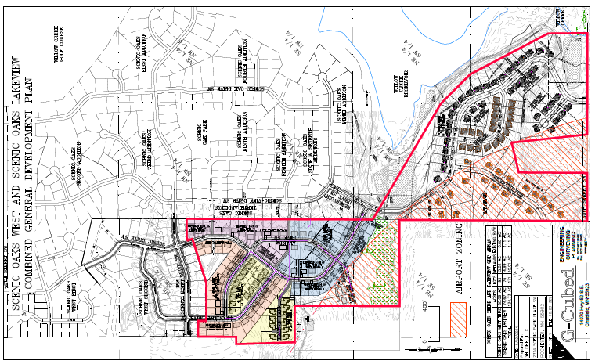
General Development Plan

Slide 8
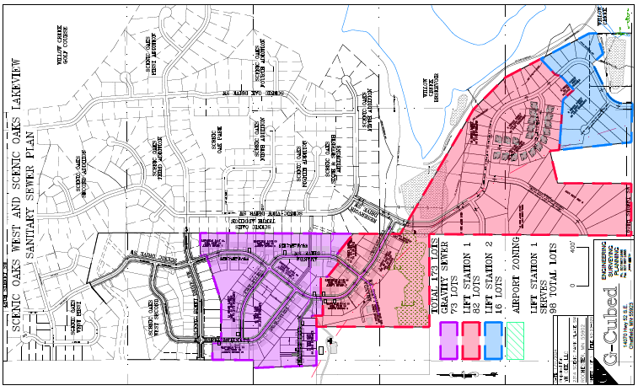
Sanitary Sewer – Gravity vs Lift Stations

Slide 9
Traffic Impacts
171 lots at 9.44 average trips per day equates to 1614 additional trips per day. The local street system was been designed for the addition of these lots.
48th Street SW had a 2018 ADT of 3350 vehicles/day and has the capacity to handle the increased traffic.
ROCOG 2045 Long Range Transportation Plan identifies intersections of 48th Street SW and 11th Ave SW and Bamber Valley Rd as low cost intersection improvement program locations.

Slide 10
Environmental Features
Wetlands on and adjacent to the site have been delineated and will be avoided to the maximum possible extent. Impacts proposed will be temporary and are attributed to extension of public utilities.
The Willow Creek Reservoir creates proximity to shoreland and floodplain features. No structures will impact either and mitigation/compliance will be addressed in permit applications.
Airport Zoning – the Property falls partially within an airport zoning overlay which requires some of the lots to be a minimum of one acres in size. The airport zoning is depicted on the exhibits.

Slide 11
Q&A

Slide 12
Still have Questions?
Contact the City of Rochester’s Community Development Department with any questions about this application type via email communitydevelopment@rochestermn.gov or phone (507-328-2600).

