Slide 1
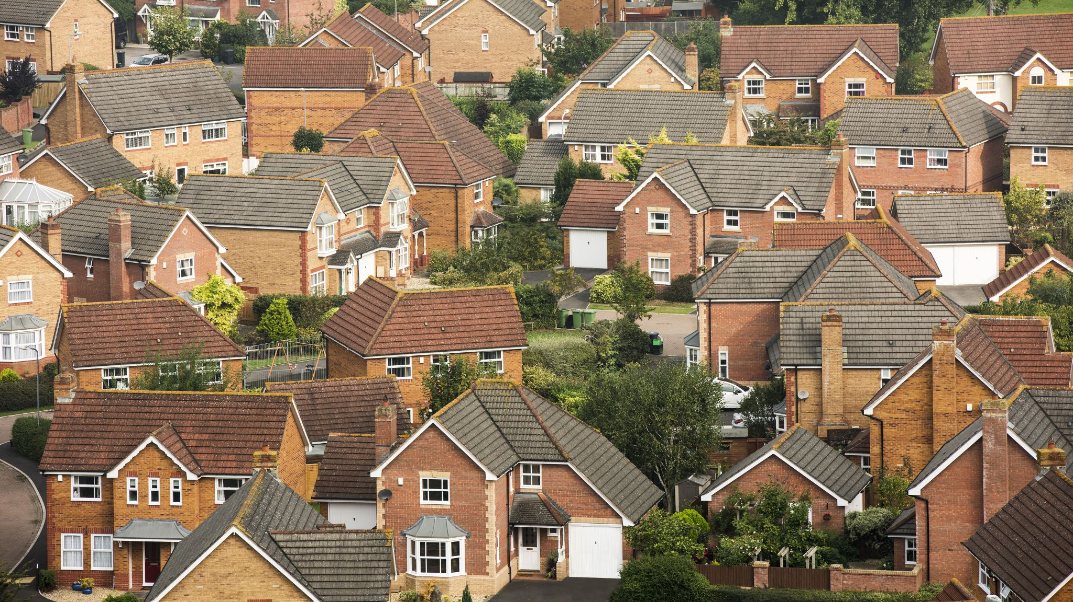
“Downtown Cottages”
Zac Boutin & John Quinn
September 26th, 2023

Slide 2
Overview
My name is Zac Boutin, and I am a part owner and the general contractor for “Downtown Cottages.”
We plan to build a 4 unit cottage home development at 520 5th Ave NW in place of an old house that had significant structural issues.
Exhibits:
Site Plan
Landscape Plan
Building Elevation
Photometric Plan
Traffic Impacts will be minimal, we expect a maximum of 4 cars in the neighborhood on any given day.
Q&A

Slide 3
Introduction
Our team consists of
John Quinn- Property manager
Carrie Quinn- Silent partner
Lauren Boutin- Designer/Manager/Realtor
Zac Boutin- Contractor/Spokesperson

Slide 4
About our Project
We will be demolishing the current house at 520 5th Ave NW to replace with 4 small homes. Each small home or “cottage,” will consist of 1 bedroom, 1 bathroom, a living room and full kitchen. Our mission is to provide high-end, yet affordable, short term rental units for Mayo guests/patients, as well as other guests of Rochester.

Slide 5
The Application Process
Applicant meets with City Teammates to review application requirements
GET INVOLVED:
Attend Applicant-hosted Neighborhood Information Meeting
Applicant submits Development Application within 30 days of Neighborhood Information Meeting
Full Application Review by City, County, & State departments within 14 days of receiving application
If application meets all requirements, application is approved
Applicant completes other required applications & sign-offs (i.e. building permit, grading permit, etc.)
Applicant proceeds with Project

Slide 6
Site Plan
The Cottages will be setback 20’ from the right aways (sidewalk and center of alley) and 10’ from the north and south property lines. They will be about 525 sq ft in size and be about 15’ tall to the peak of the roof line. Each unit will have its own parking stall with tasteful landscaping.

Slide 7
Landscape Plan
We plan to plant several native trees, bushes, and flowers around this property. Flowers and bushes will be planted on the west side (5th Ave) along the sidewalk and in front of each unit to give it an appealing, comforting look. An inground sprinkler system will be installed to ensure we get good flower blooms and have healthy grass throughout the Summer months. Native trees will be planted on every side of the lot as space allows. Special attention will be paid to ensure the species of trees will not over grow, like neighboring lots have.

Slide 8
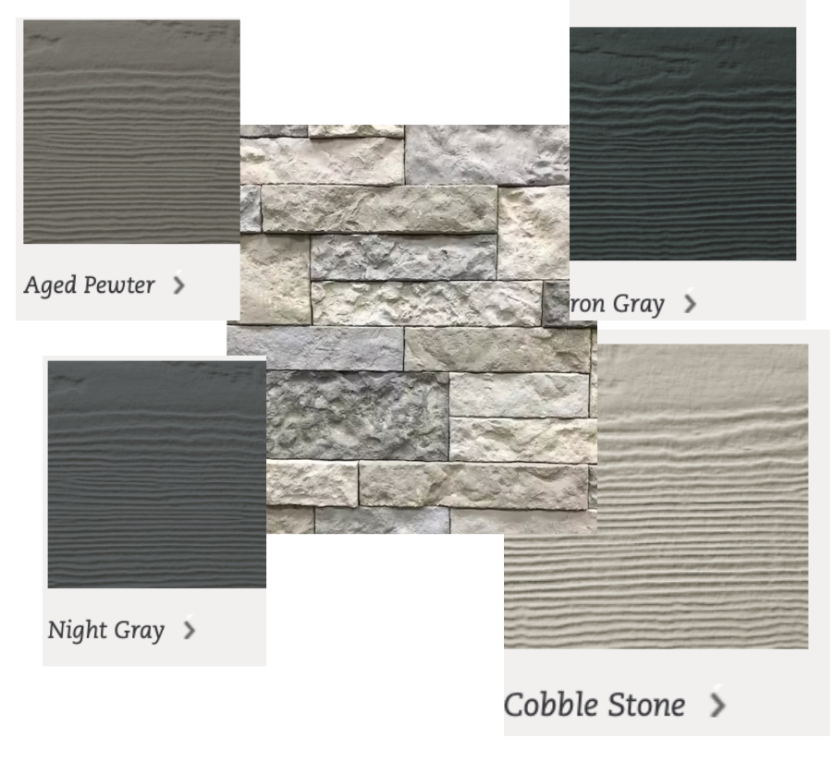
Building Elevation
The cottage homes will be slab on grade (no basement) standing approximately 15’ tall to the peak of the roof. They will be 32’ long and 16’ wide with a tastefully designed exterior.
Add Exhibit/Pictures

Slide 9
Lighting Plan
See yellow small circles, on the front of each cottage next to the front door – upon approach. Lights will be a typical exterior house light.

Slide 10
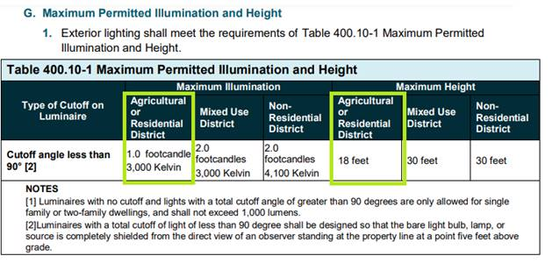
Lighting Plan
Lighting is not permitted to exceed 1 foot candle at property line, 3000 kelvin and can be no higher than 18 feet on the building.
This type of lighting will be a warm lighting color. 1 foot-candle maximum will ensure excessive light does not spill onto neighboring properties
Lighting place on building will be located no higher than 7 feet above grade.
City of Rochester Unified Development Code

Slide 11
Traffic Impacts
If the units are fully occupied, we expect 4 vehicles per day, with maybe 3 trips in and out per day. A guesstimate of 24 total in and outs per day. If guests are in town visiting The Mayo Clinic, we assume there will be walking guests as well. This is just an estimate.

Slide 12
Q&A

Slide 13
Still have Questions?
Contact the City of Rochester’s Community Development Department with any questions about this application type via email communitydevelopment@rochestermn.gov or phone (507-328-2600).

