Slide 1
CENTURY VILLAGE
Bob Fleming-Bella Terra LLC
12-7-2023

Slide 2
Overview
Introductions
About our Project
The Application Process
Exhibits:
Existing Zoning District-R-2
Proposed Street Layout and Unit Densities
Future Project Details
Traffic Impacts
Existing & Future Environmental Features
Q&A

Slide 3
Introduction
Bella Terra LLC- Bob Fleming, developer
SEH Inc. – Bill Anderson, engineer
_ Dan Horsch, engineer

Slide 4
About our Project
Proposed project will include 33-4plex townhomes on a new 28’ wide public street. Project will also include new stormwater facilities, sidewalks, bituminous trail on Silver Creek Road, off street parking lot and boulevard trees.

Slide 5
The Application Process
Applicant meets with City Teammates to review application requirements
GET INVOLVED:
Attend Applicant-hosted Neighborhood Information Meeting
Applicant submits Development Application within 30 days of Neighborhood Information Meeting
Full Application Review by City, County, & State departments within 14 days of receiving application
GET INVOLVED:
Attend the Planning & Zoning Commission Meeting, where a recommendation will be made to City Council
GET INVOLVED:
Attend the City Council Public Hearing, where a decision will be made on the application
Applicant completes other required applications & sign-offs (i.e. minor land subdivision permit or final plat, etc.)
Applicant proceeds with Project

Slide 6
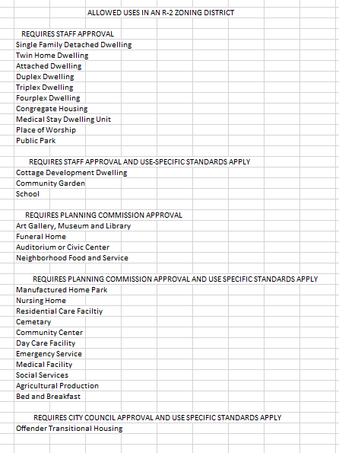
Existing Zoning District
Description (including all permitted uses in the existing zoning district).

Slide 7
Proposed Street Layout & Unit Densities
28 foot curb and gutter street with cul-de-sac serving 33 -4 plex townhomes with on street parking in some areas and additional parking off the cul-de-sac.
Project will also include reconstruction of the first 600 feet of Silver Creek Road.
Project also includes a stormwater treatment pond and access driveway to the existing stormwater pond north of the subdivision.
Project will retain much of the existing trees on the east and north side of the site.

Slide 8
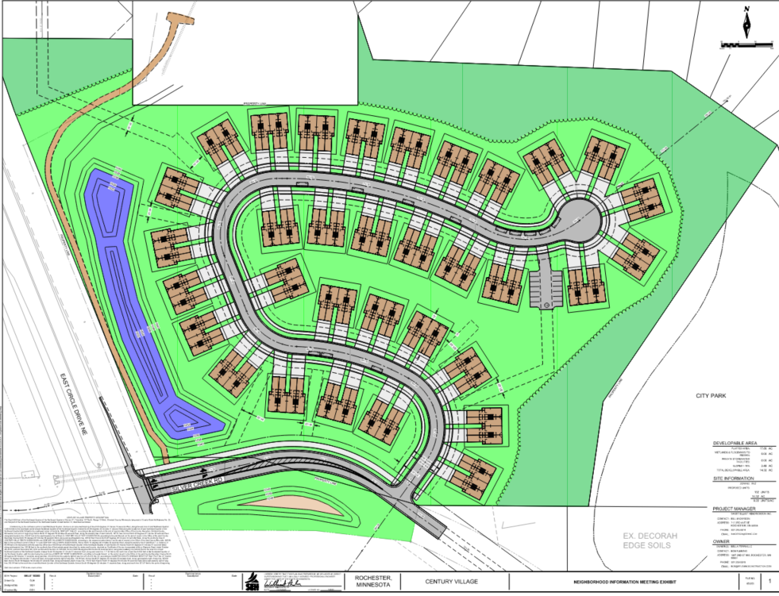

Slide 9
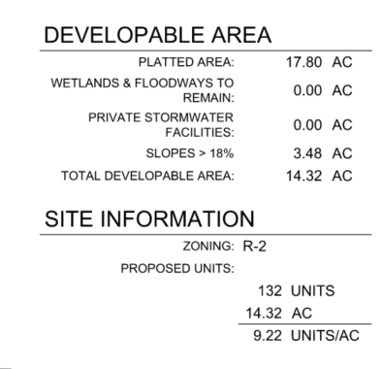
Future Project Details
Description. Project will likely be completed in two phases with the reconstruction of Silver Creek Road NE and the stormwater ponds included in the first phase.
The second phase will be constructed as market conditions allow.

Slide 10
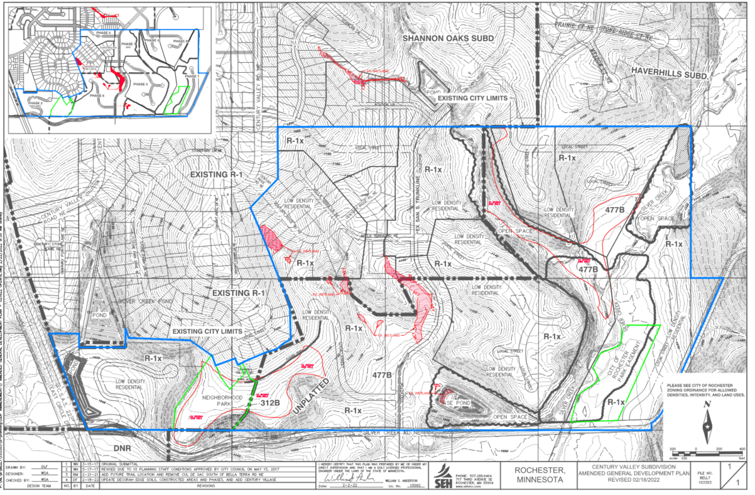

Slide 11
Traffic Impacts
A traffic impact study was completed for the entire Century Valley GDP in 2022 along with a preliminary design for the future reconstruction of Silver Creek Road. The traffic generation for this project (Century Village) was updated for this proposed project and presented to Rochester Public Works for a Traffic Impact Wavier based on minimum impact to the previous traffic study.
Daily total increase of 950 ADT and Peak AM hour 63, Peak PM hour 75
At some future date when Stonehedge Drive is connected to Silver Creek Road and Silver Creek Road NE is reconstructed to East Circle Drive a traffic signal will be needed at the intersection of East Circle Drive and Silver Creek Road NE.

Slide 12
Existing & Future Environmental Features
The existing 17.8 acres has some decorah edge soils on the very east limit of the property along the City Park, which will not be disturbed by this project. As much of the existing tree cover as possible will be retained. Boulevard trees will be installed with the new roadway. The new stormwater treatment ponds will be added including two pre-treatment bays and an infiltration basin.

Slide 13
Q&A

Slide 14
Still have Questions?
Contact the City of Rochester’s Community Development Department with any questions about this application type via email communitydevelopment@rochestermn.gov or phone (507-328-2600).

