Slide 1
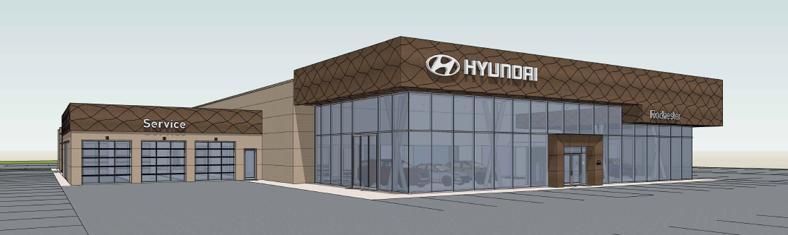
Happy Hyundai of Rochester
Leo & Ed, LLC
September 19, 2023

Slide 2
Overview
Introductions
About our Project
The Application Process
Exhibits:
Site Plan
Landscape Plan
Building Elevation
Photometric Plan
Traffic Impacts
Q&A

Slide 3
Introduction
Property Owners – Bret Matthews, Jim Spellman
Architecture – John Madeja, RA, Studio 222 Architects
Civil Engineering – Roger Humphrey, PE, GRAEF
Landscape – Joe Pepitone, PLA, GRAEF
Construction Managers – Scott Richards, Nicholas and Associate
– Brock Erickson, Kraus-Anderson Construction

Slide 4
About our Project
The project includes demolition of the existing Lincoln Dealership building located on the site, construction of a new, approximately 25,000 sf, one-story, Hyundai Prototype building, installation of new landscaping, and parking reconfiguration.

Slide 5
The Application Process
Applicant meets with City Teammates to review application requirements
GET INVOLVED:
Attend Applicant-hosted Neighborhood Information Meeting
Applicant submits Development Application within 30 days of Neighborhood Information Meeting
Full Application Review by City, County, & State departments within 14 days of receiving application
If application meets all requirements, application is approved
Applicant completes other required applications & sign-offs (i.e. building permit, grading permit, etc.)
Applicant proceeds with Project

Slide 6
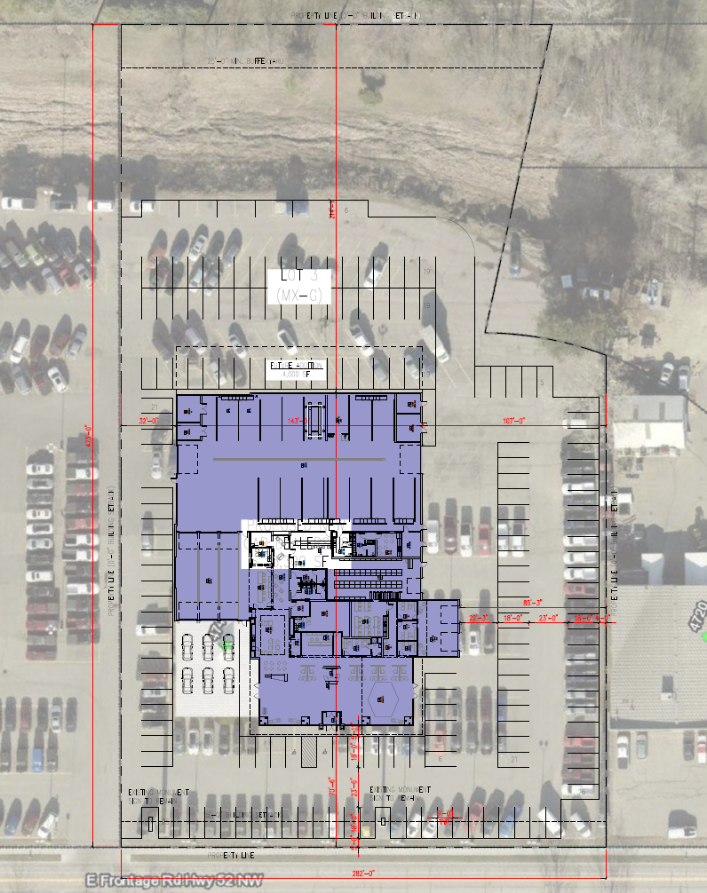
Site Plan
The building is located in the MX-G zoning district with an approximate site area of 124,831 sf and will include 178 parking spaces. The proposed 25,000 sf, 26 feet tall, one-story building will consist of a showroom, sales area, business offices, and service center

Slide 7
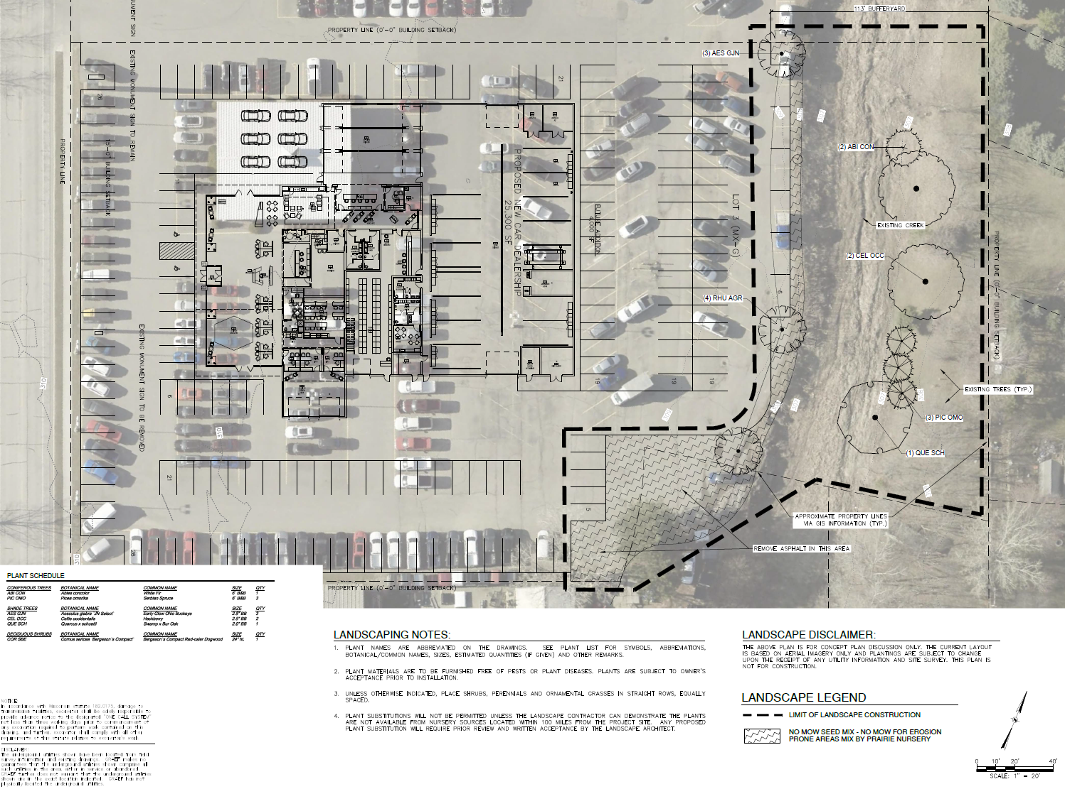
Landscape Plan
New buffer landscaping will be installed along the norther property line consisting of new trees as depicted on the landscape plan

Slide 8
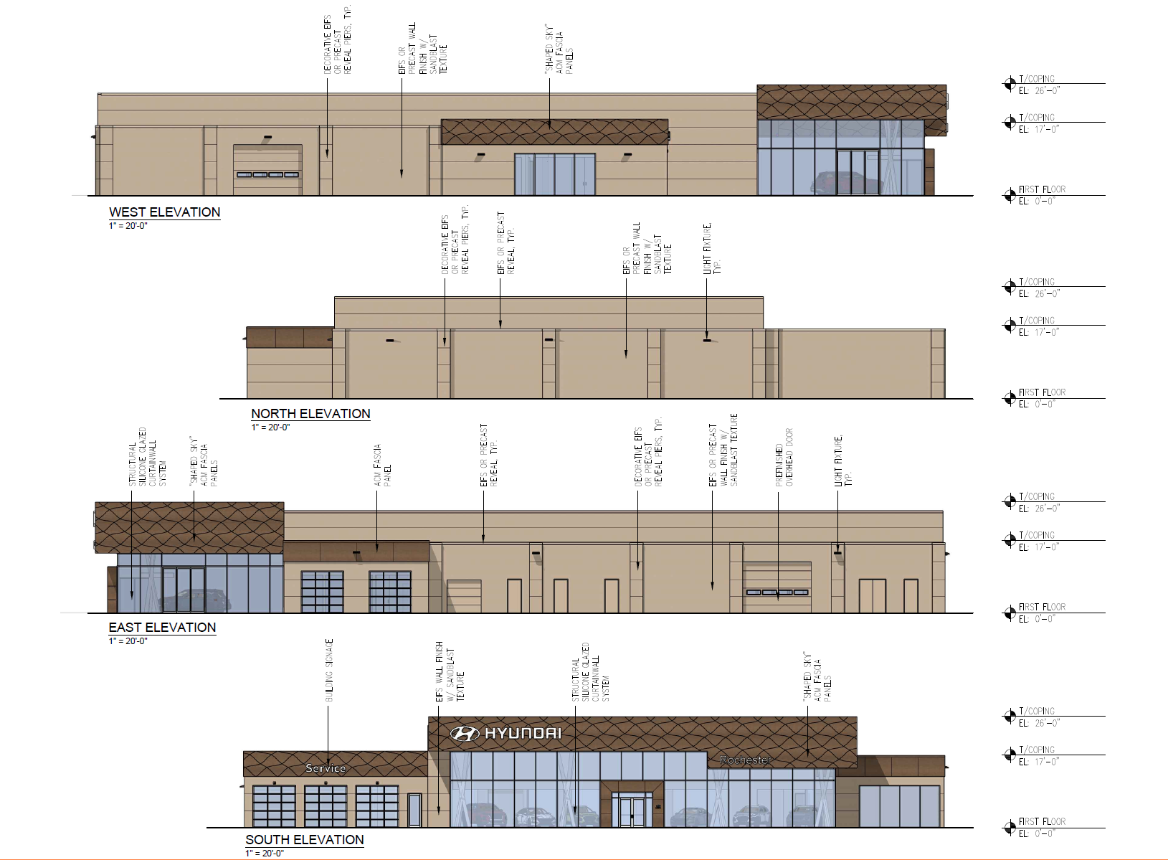
Building Elevation
The street facing façade will consist of aluminum curtainwall system and sky shaped composite metal panel. The sides and back of building will primarily consist of either precast wall panel or EIFS finish with decorative piers and reveals.

Slide 9
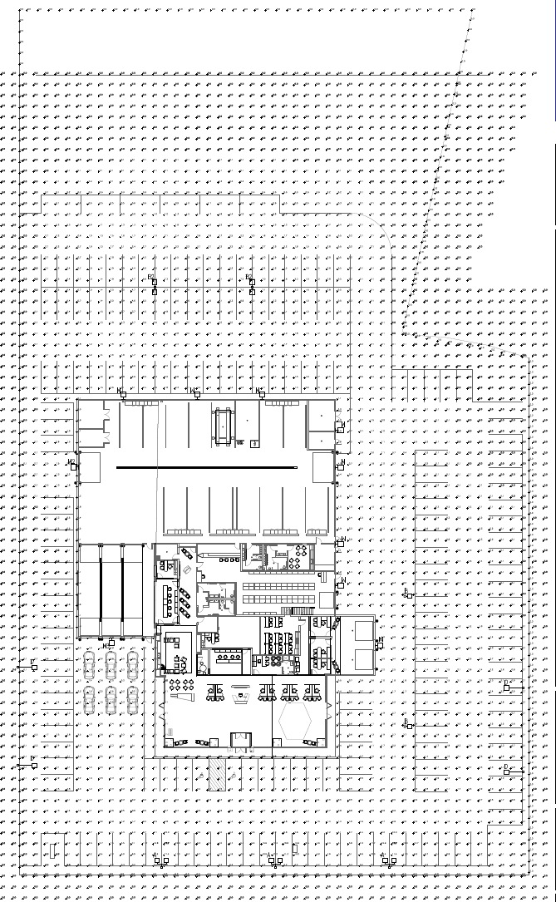
Photometric Plan
New site and building lighting will be installed meeting City of Rochester site lighting standards

Slide 10
Traffic Impacts
The redevelopment is expected to result in an increase in overall trips to the site, with an additional 35 vehicle trips during the weekday morning and evening peak hours and an additional 85 vehicle trips during the Saturday midday peak hour.

Slide 11
Q&A

Slide 12
Still have Questions?
Contact the City of Rochester’s Community Development Department with any questions about this application type via email communitydevelopment@rochestermn.gov or phone (507-328-2600).

