Slide 1
BLOSSOM VILLAS REZONING NIM
MEIER COMPAIES
WSE MASSEY ENGINEERING & SURVEYING
AUGUST 15

Slide 2
Overview
Introductions
About our Project
The Application Process
Exhibits:
Current & Proposed Zoning Map
Massing Permitted
Dimensional Standards
Permitted Uses of the Existing & Proposed Zoning Districts
Traffic Impacts
Q&A

Slide 3
Introduction
Owner – Meier Companies, Paul Meier
Consultant – WSE Massey Engineering, Bill Tointon & Ryan Schoenfelder

Slide 4
About our Project
Rezoning request from “Holding Zone” to “R-3”
Annexation
Land Use determines zoning when annexed into the city
Land Use was approved from Low Density to Medium Density

Slide 5
The Application Process
Applicant meets with City Teammates to review application requirements
GET INVOLVED:
Attend Applicant-hosted Neighborhood Information Meeting
Applicant submits Development Application within 30 days of Neighborhood Information Meeting
Full Application Review by City, County, & State departments within 14 days of receiving application
GET INVOLVED:
Attend the Planning & Zoning Commission Meeting, where a recommendation will be made to City Council
GET INVOLVED:
Attend the City Council Public Hearing, where a decision will be made on the application
Applicant completes other required applications & sign-offs (i.e. GDP, Final Plat, SDP, CUP, etc.)
Applicant proceeds with Project

Slide 6
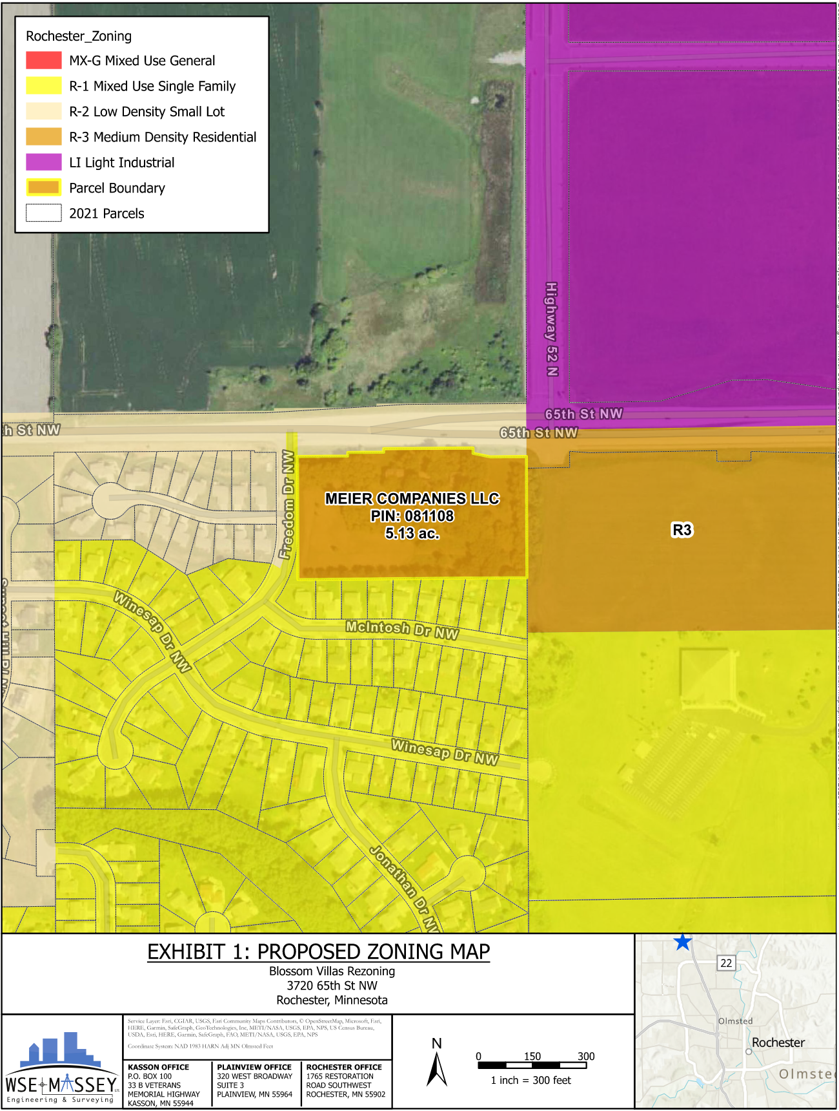
Current & Proposed Zoning Map
Proposed zoning map only shown.
Existing Zoning – Holding Zone
Proposed Zoning – R-3

Slide 7
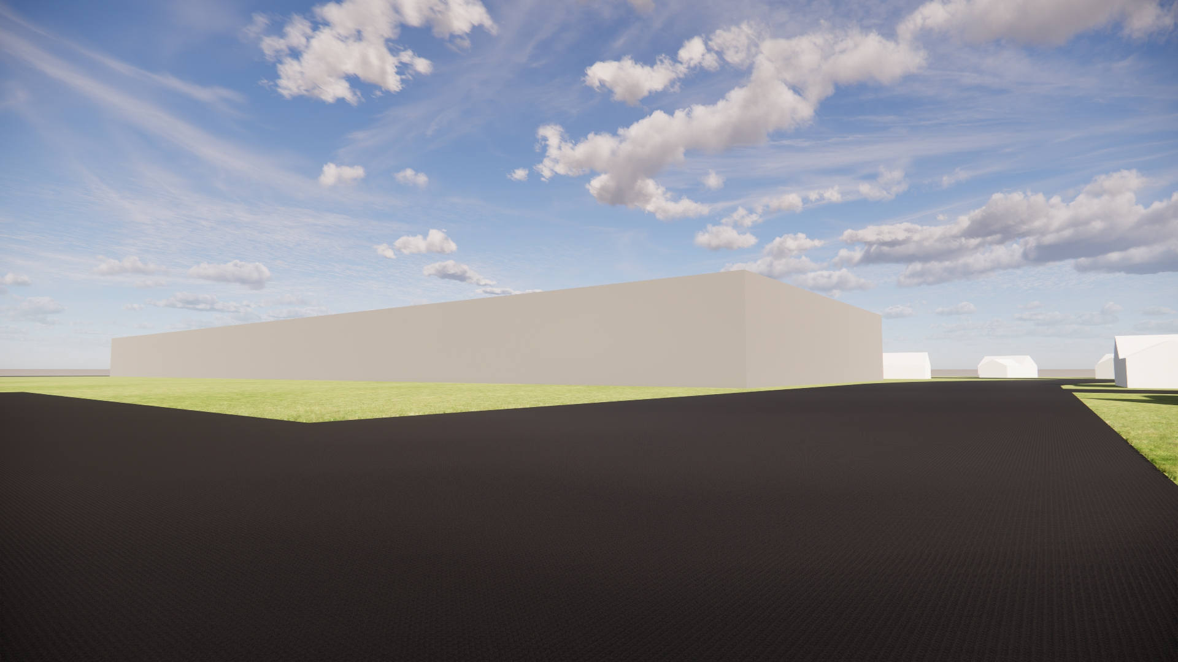
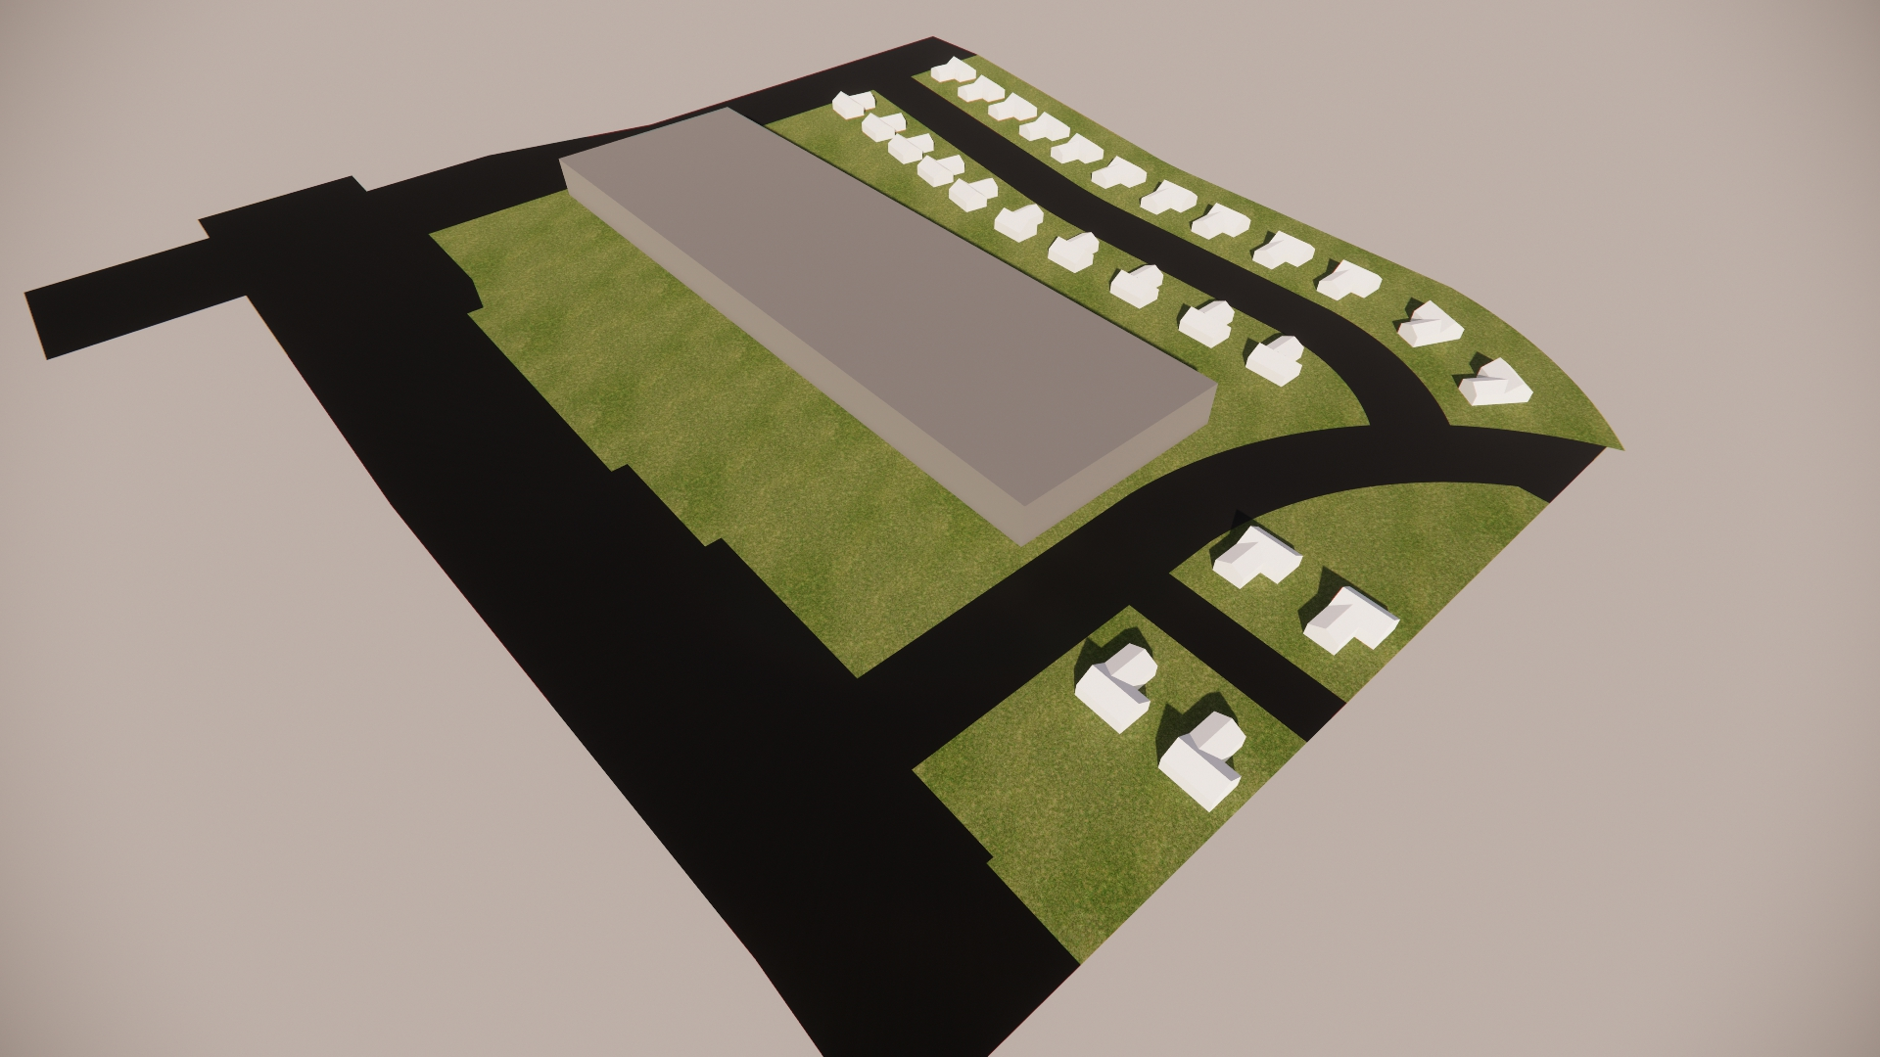
Massing Permitted
R-3
48’ Height (maximum)
1.5 Floor area ratio (FAR)
Neighborhood protection
35’ Height (maximum) within 100’ of residential zoning district
Add Exhibit/Pictures

Slide 8
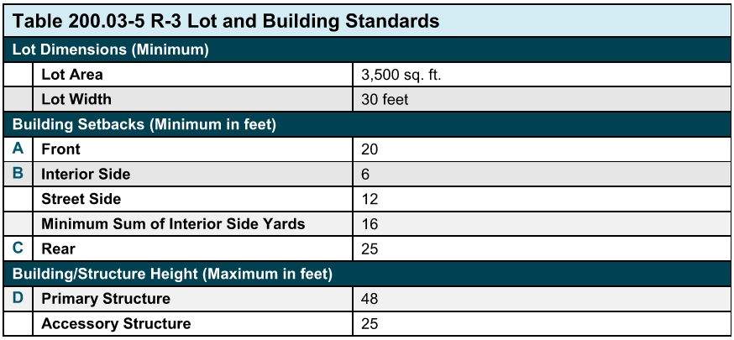
Dimensional Standards
R-3 Dimensional Standards shown. Holding zone has standards per UDC code.

Slide 9
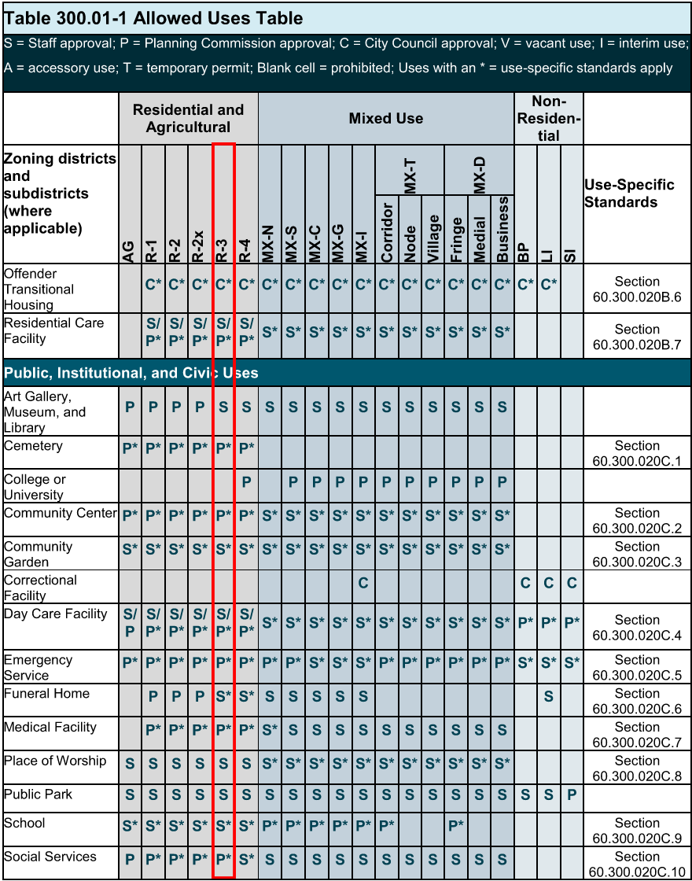
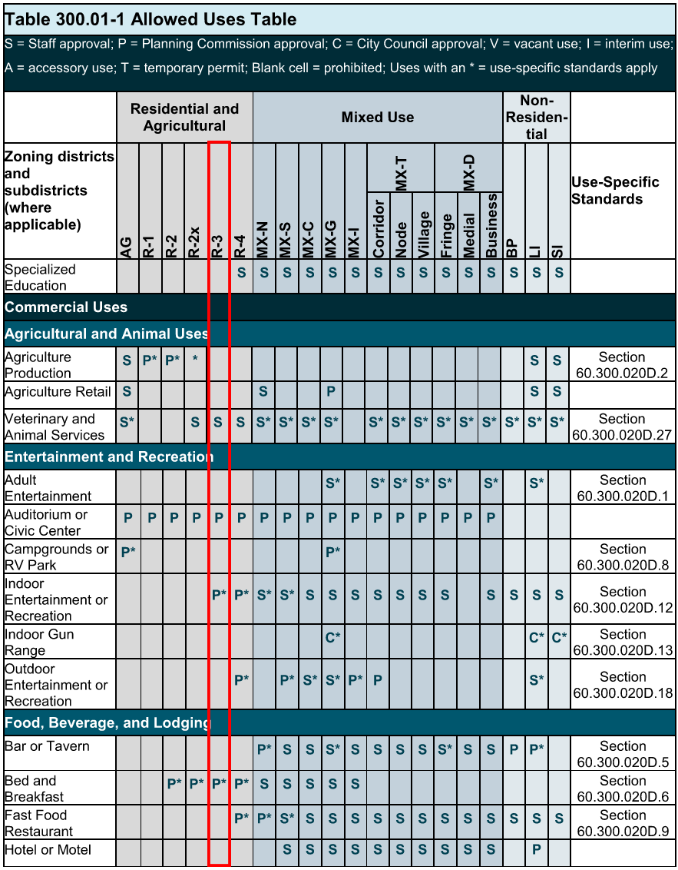
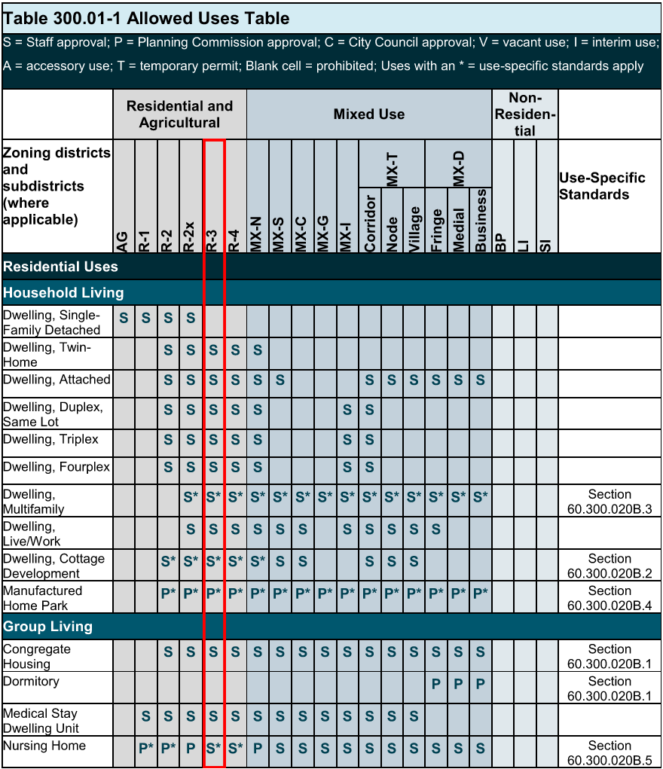
Permitted Uses of the Existing & Proposed Zoning Districts
Proposed R-3 Zoning uses shown. Staff approval for Multifamily Dwellings.

Slide 10
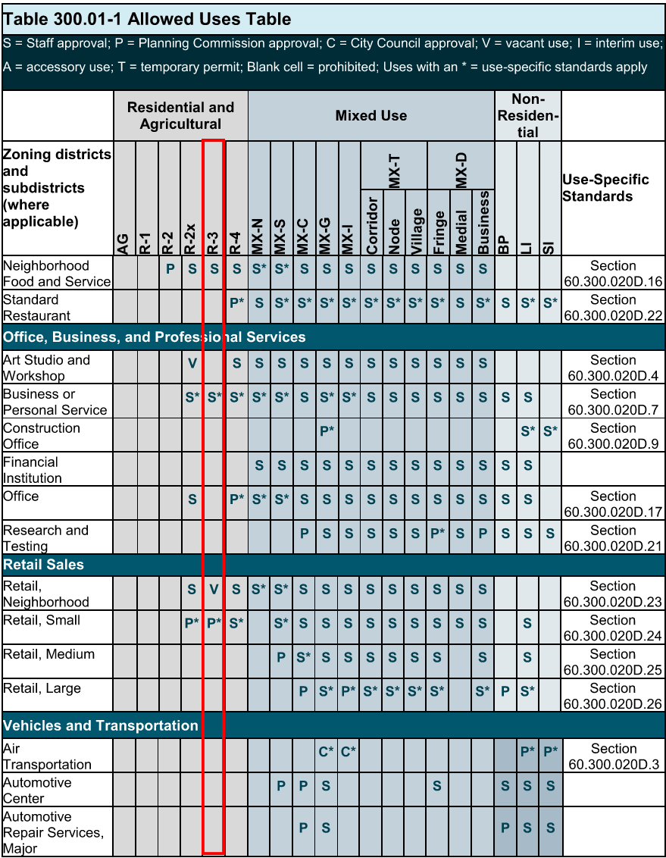
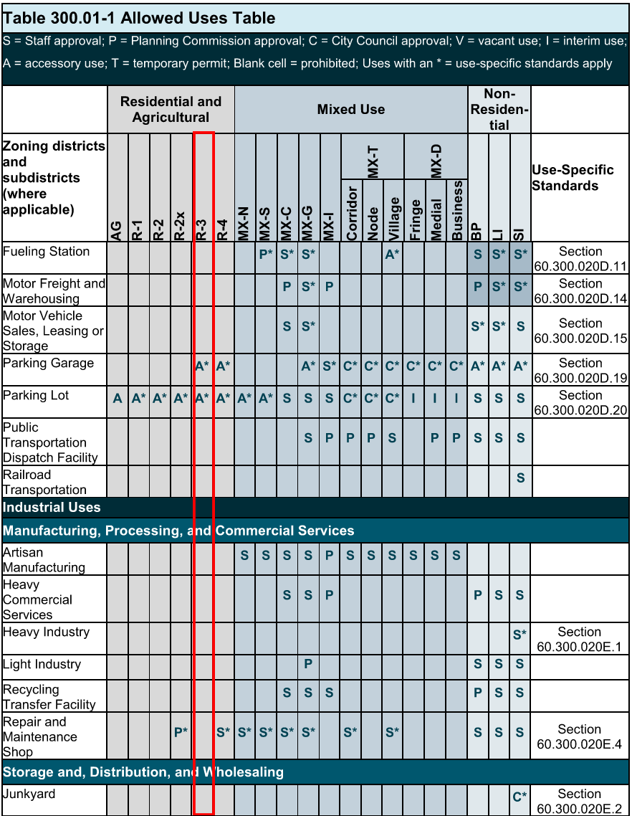
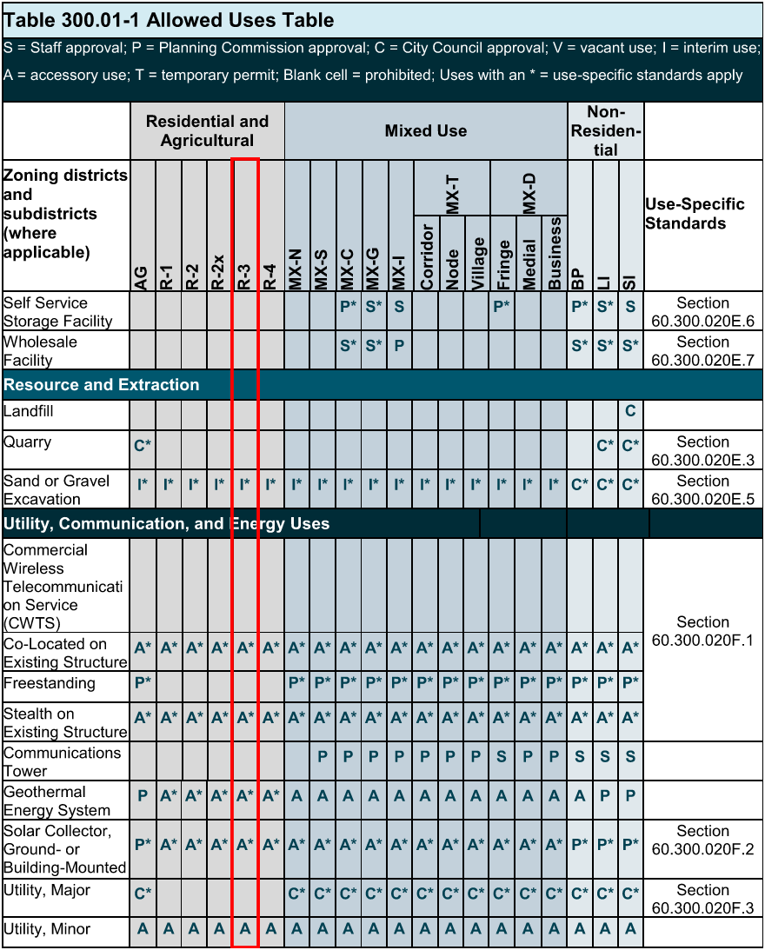
Permitted Uses of the Existing & Proposed Zoning Districts

Slide 11
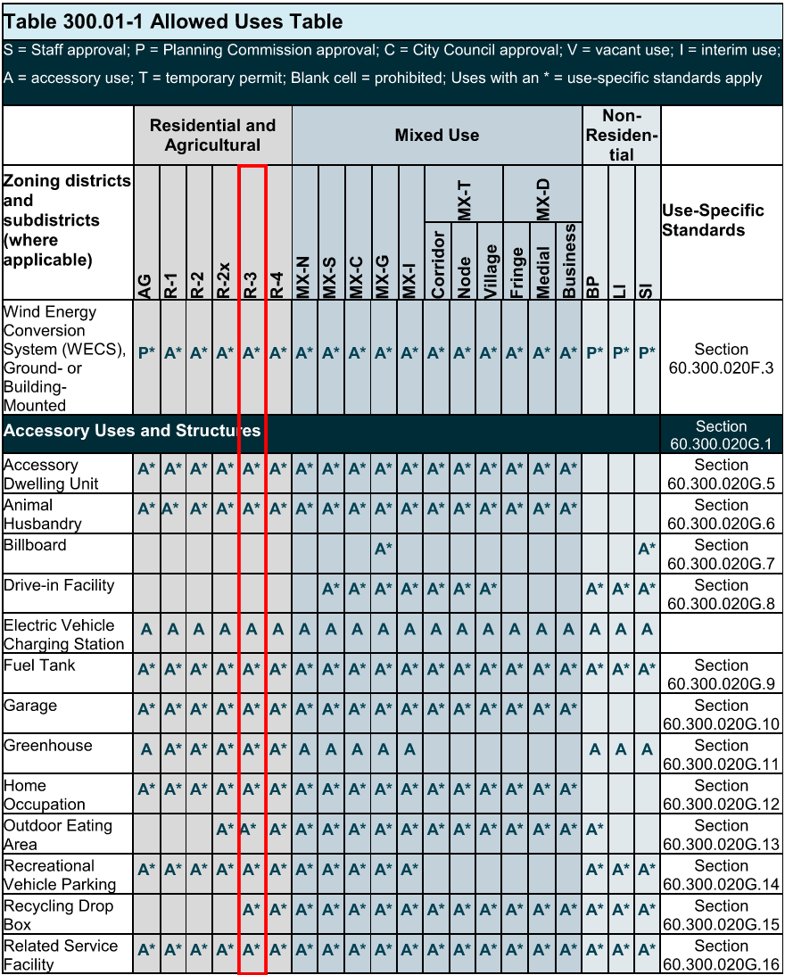
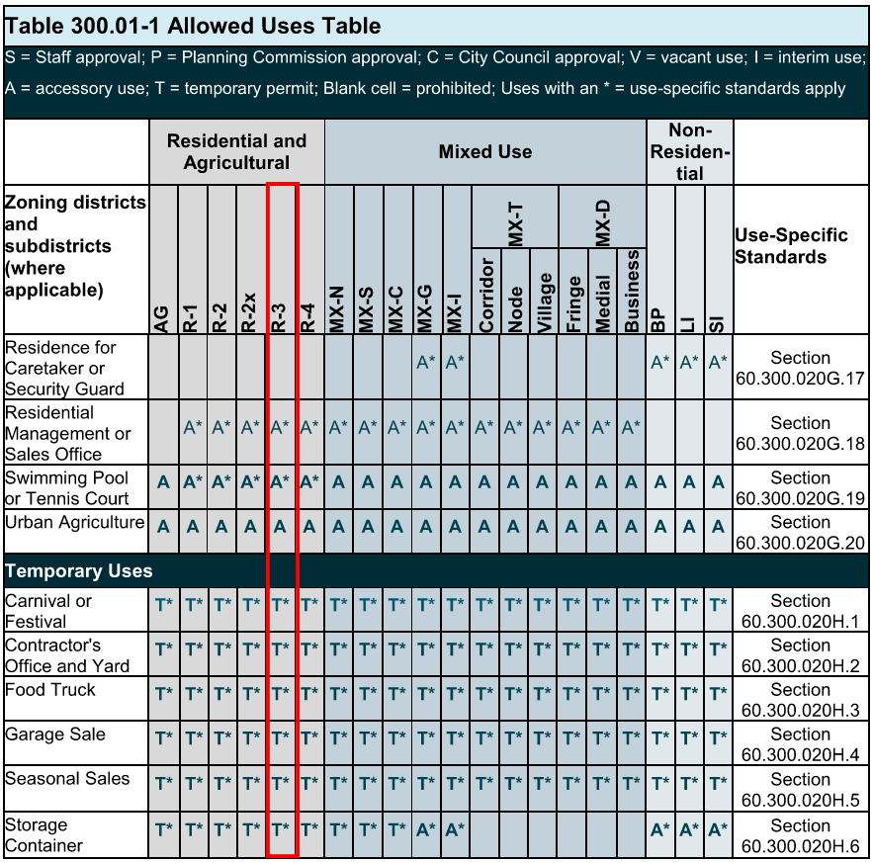
Permitted Uses of the Existing & Proposed Zoning Districts

Slide 12
Traffic Impacts
A traffic waiver was signed by the city engineer for the land use amendment. An updated waiver was requested for the rezoning based on the previous 65th St NW study. Below is the previous determination based on R-3 zoning with the maximum intensity.
65th St NW will be upgraded along with the construction of 37th Ave NW.

Slide 13
Existing & Future Environmental Features
A wetland investigation identified some potential wetlands on the West side of the parcel. A wetland delineation will be completed and certified by Olmsted County prior to development.
The reconstruction project of 65th St NW by the city has removed many of the trees along the 65th St NW corridor.
Boulevard trees will be planted along Freedom Dr & 37th Ave

Slide 14
Q&A

Slide 15
Still have Questions?
Contact the City of Rochester’s Community Development Department with any questions about this application type via email communitydevelopment@rochestermn.gov or phone (507-328-2600).

