Slide 1
RPD Addition
TLS Companies, LLC

Slide 2
AGENDA
Introduction
Site Plan
Landscape Plan
Elevation
Traffic
Closing

Slide 3
INTRODUCTION
Construction of a 1,200 sf addition that will add (4) chairs for pediatric care, one office for patient care, a consultation room and a large waiting area for families

Slide 4
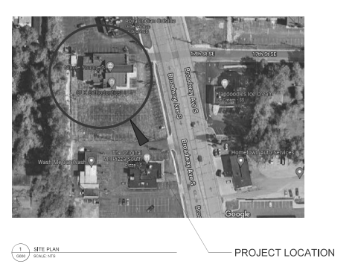
Location

Slide 5
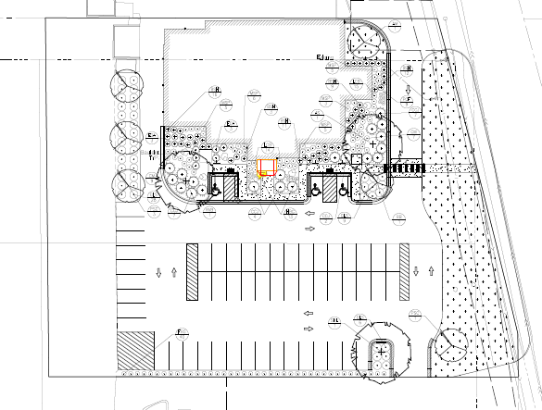
Site/Landscape Plan

Slide 6
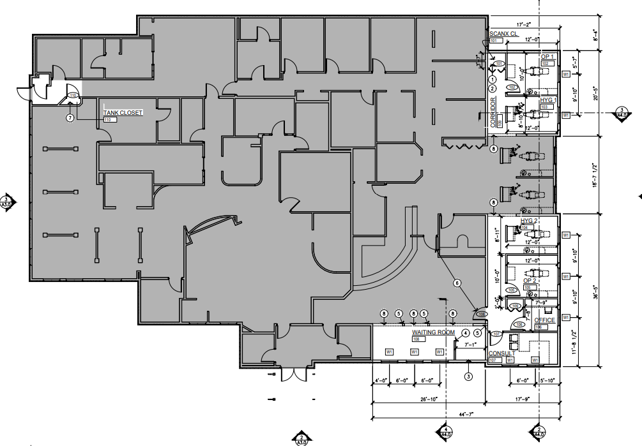

Slide 7
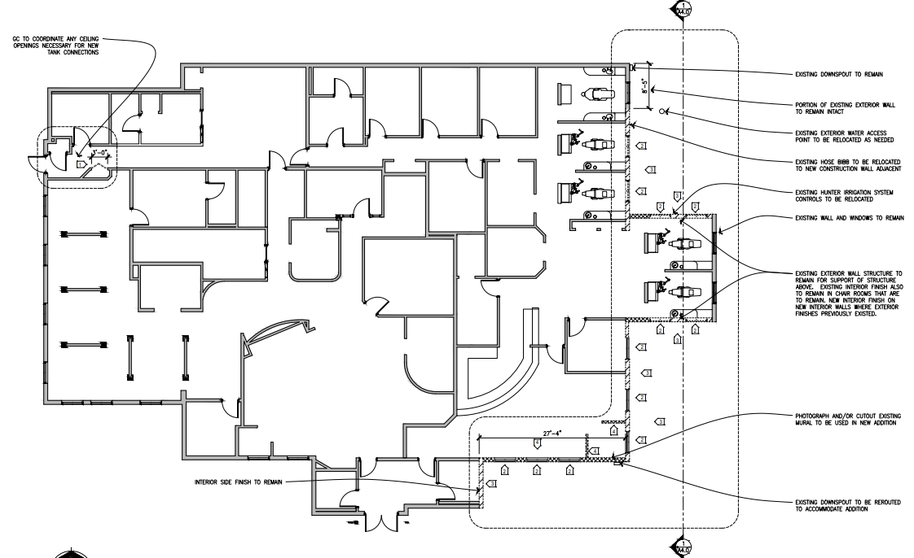

Slide 8
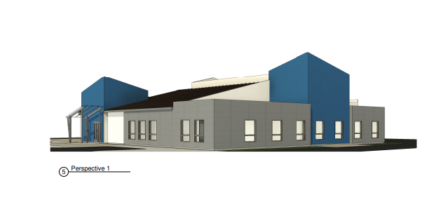
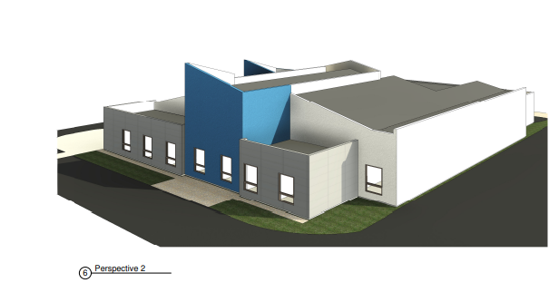

Slide 10
THANK YOU
TLS Companies, LLC Todd Severson
tseverson@tlscompanies.com
507-322-0100

