Slide 1
Proton Therapy Expansion
Mayo Clinic
4.18.23

Slide 2
Overview
Introductions
About our Project
The Application Process
Exhibits:
Site Plan
Landscape Plan
Building Elevation
Photometric Plan
Traffic Impacts
Q&A

Slide 3
Introduction
Mayo Clinic: Karl Corrigan
Division Chair Facilities Project Services
Stantec: Paula Williams
Particle Therapy – Principal-In-Charge + Project Manager
Franck Le Bousse
Particle Therapy – Lead Design
Joe Palen
Civil Engineer
RSP: Jasen Andring
Local Architectural Coordination

Slide 4
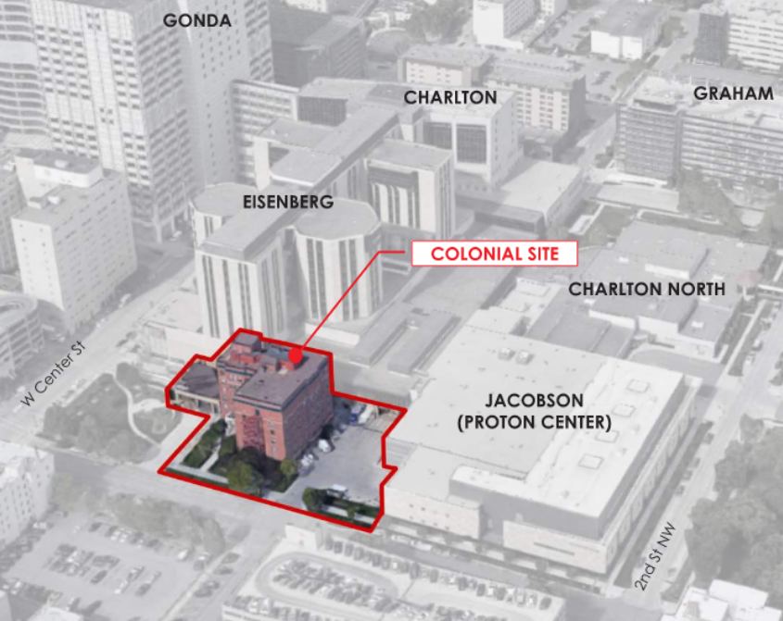
About our Project
Mayo Clinic Rochester is planning the expansion of their radiation oncology department on the site previously occupied by the now-demolished Colonial Building located between West Center St and 1st Ave NW. The new facility will add two new proton treatment rooms to the four currently in operation. Its design will feature a seamless experience for proton therapy patients and their families. The new addition will be located adjacent to the existing Eisenberg Building and connect to the currently operational proton center housed in the Jacobson Building. It will maintain its own architectural identity while still blending with the vision for the overall campus masterplan. The renovation of the existing facility will provide for a full integration of the clinical functions associated with proton therapy.

Slide 5
The Application Process
Applicant meets with City Teammates to review application requirements
GET INVOLVED:
Attend Applicant-hosted Neighborhood Information Meeting
Applicant submits Development Application within 30 days of Neighborhood Information Meeting
Full Application Review by City, County, & State departments within 14 days of receiving application
If application meets all requirements, application is approved
Applicant completes other required applications & sign-offs (i.e. building permit, grading permit, etc.)
Applicant proceeds with Project

Slide 6
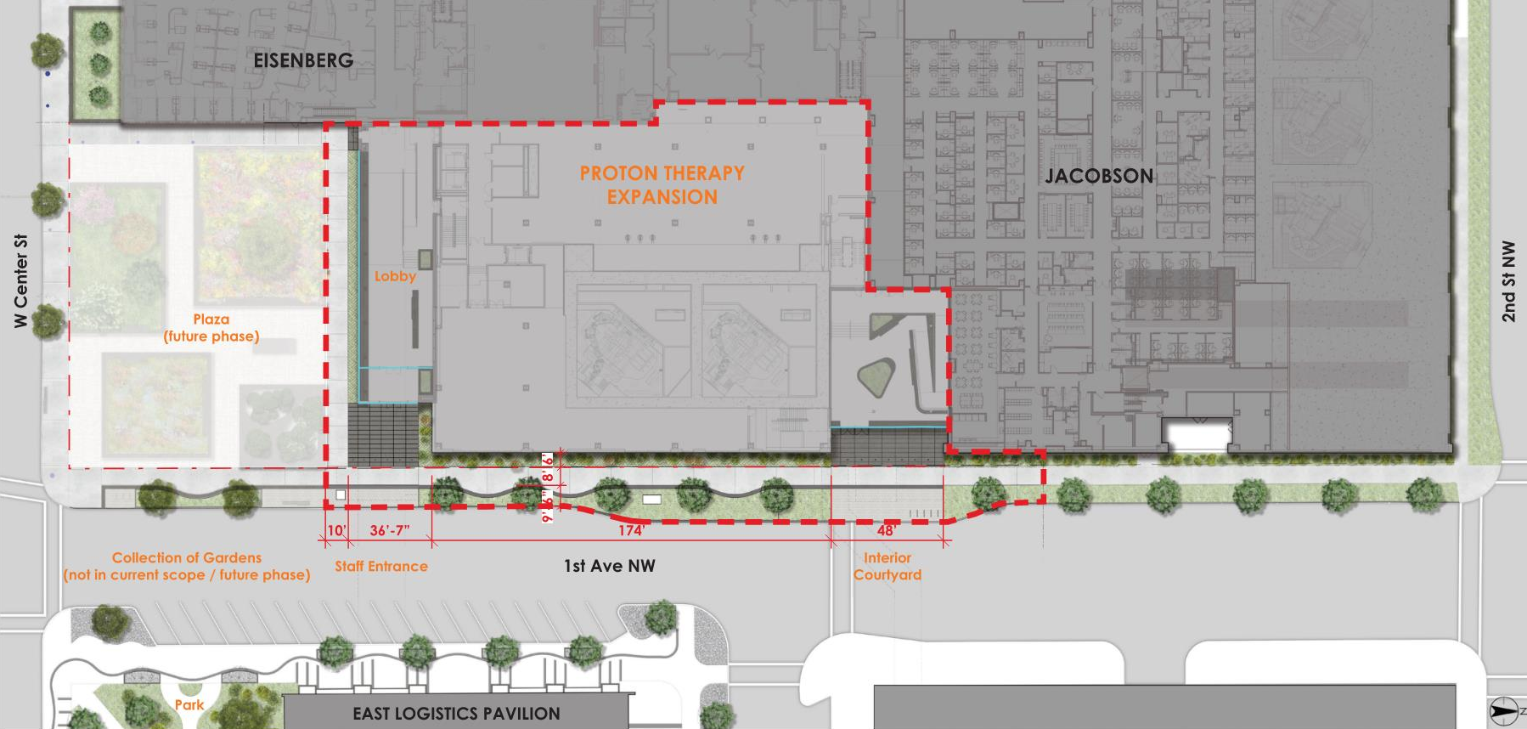
Site Plan
^{ZONE DISTRICTS:}
^{MX-D}
Mixed Use Downtown/Medical Subdistrict
^{USE REGULATIONS:}
^{Medical Facility}
^{Allowed}
^{Use Specific Standards – N/A}
DEVELOPMENT STANDARDS AND INCENTIVES:
^{Dimensional Standards}
^{• Lot Dimensions None}
^{• Building Setbacks None}
• Building Height 185’ Allowed/53’ Provided
^{• Max Building Length None}
^{• Max Floor Area Ratio None}
• Minimum Landscape Area 8% (Will comply as part of the design of the future garden at the intersection of 1st Ave and W. Center St.)

Slide 7
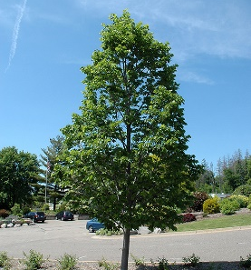
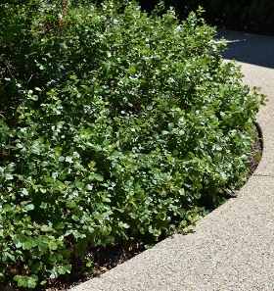
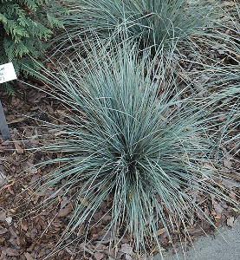
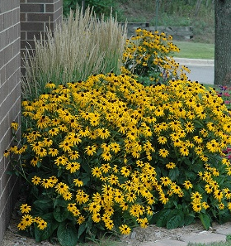
Landscape Plan
Landscaping, Buffer-yards, and Fences
• Boulevard work within the project scope will be performed under agreement between Mayo Clinic and the City of Rochester as part of the City’s 1st Ave street work.
• General landscaping will be provided in the indicated areas along the edge of the building. A landscape plan will be submitted as part of the Site Development Plan application.
• Minimum planting requirements do not apply in the MX-D district.
Boulevard Linden
Gro-low Fragrant Sumac
Sapphire Blue Oat Grass
Goldsturm Rudbeckia

Slide 8
Building Elevation - East
^{SITE & BUILDING DESIGN}
• All sides of each façade is designed to provide architectural and visual interest.
• Building shall be constructed of high quality, durable materials (stone, metal panel are provided)
^{• Transparency}
o Ground floor glazing shall occupy 65% of each street facing façade – translucent and colored glass provided along 1st Ave.
o Upper-level glazing shall occupy 30% of each street facing façade – not feasible to provide along 1st Ave due to technical requirements of proton therapy vault.
^{ELEVATION LEGEND}
^{Existing Building}
^{Glass}
^{Glass – Colored}
^{Stone Cladding}
^{Metal Panel}
• Roof Mounted Equipment is not provided.
^{• Horizontal Articulation}
o Two or more elements to be incorporated every 60 horizontal feet – will be provided using change of texture, patterns and materials.
o Building Facades 150’ or Longer – provide a Forecourt or a Top Floor Stepback – will be provided by a forecourt at both staff entrances.
^{staff entrances.}

Slide 9
Building Elevation - South
^{ELEVATION LEGEND}
^{Existing Building}
^{Glass}
^{Glass – Colored}
^{Stone Cladding}
^{Metal Panel}
• Canopy continues through Entry Vestibule
• Exterior high quality, durable materials continue through Lobby back wall intersected with decorative finishes (green wall, wood, etc.)
^{• Sculptural ceiling features}
^{• built-in planters}
OVERALL EXTERIOR BUILDING ELEVATION – SOUTH
.
OVERALL BUILDING ELEVATION – SOUTH
INTERIOR LOBBY - HORIZONTAL ARTICULATION

Slide 10
Site Lighting Plan
^{Exterior Lighting}
• On-site or building mounted pedestrian- oriented lighting will be provided to comply with the requirements.
• Lighting to be designed to minimize light pollution & maintain nighttime safety
^{• Proposed Fixtures}
^{o Canopy Lighting}
^{o Existing Street Lights}
^{o Entry Lighting}
^{o Light Bollards}
• Photometric Plan will be developed with selection of final fixtures
^{PLAN LEGEND}
^{Street Lights}
^{Canopy w/ downlights}
^{Interior Glass Lobby}
^{Exterior Wall Sconce}

Slide 11
Traffic Impacts
No additional vehicular traffic will be generated

Slide 12
Q&A

Slide 13
Still have Questions?
Contact the City of Rochester’s Community Development Department with any questions about this application type via email communitydevelopment@rochestermn.gov or phone (507-328-2600).

